Slide 1
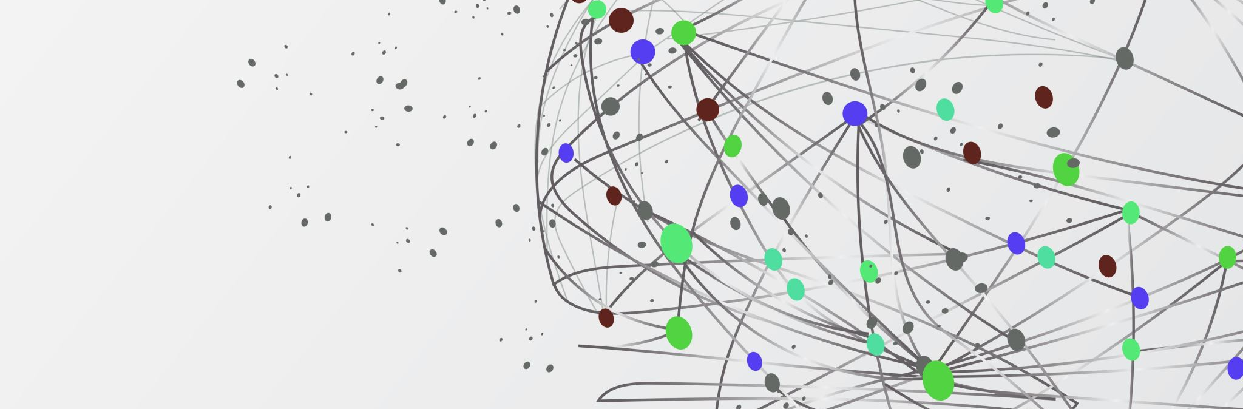
Bioinformatics Tutorial
Wednesday November 8, 2023

Slide 2
Class Overview
Overview of GitHub
Making your own account
Downloading and uploading files through GitHub
Overview of RNAseq workflow
Differential expression tutorial using Deseq2

Slide 3
Github overview
Github is a tool that helps users store and manage their code
It also allows users to track and control changes to their code.
Anyone can sign up and host a public code repository for free, which makes GitHub especially popular with open-source projects.
GitHub also serves as a social networking site where developers can openly network and collaborate.
Overall GitHub allows users create accounts, upload files, and create coding projects.
GitHub becomes very useful when users begin to collaborate.

Slide 4
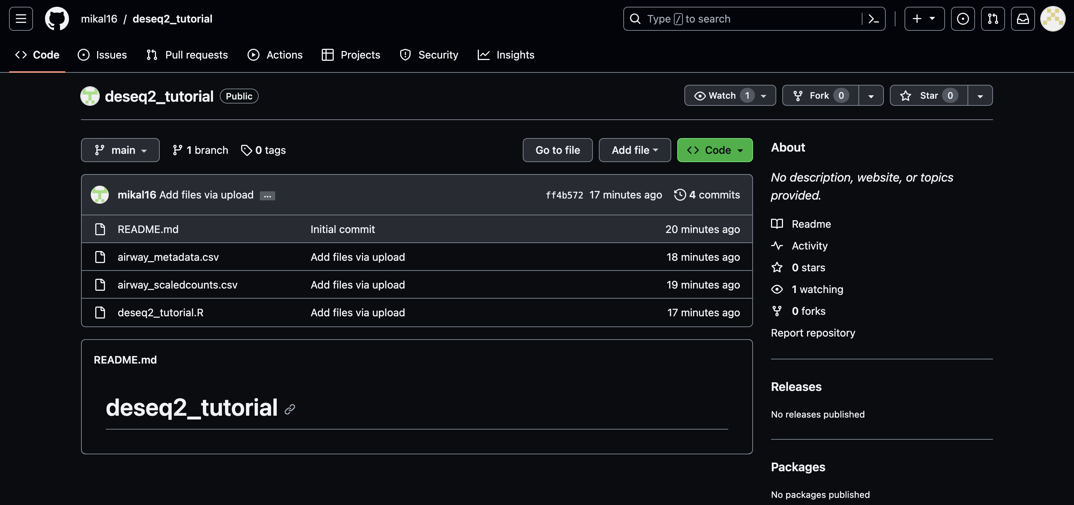
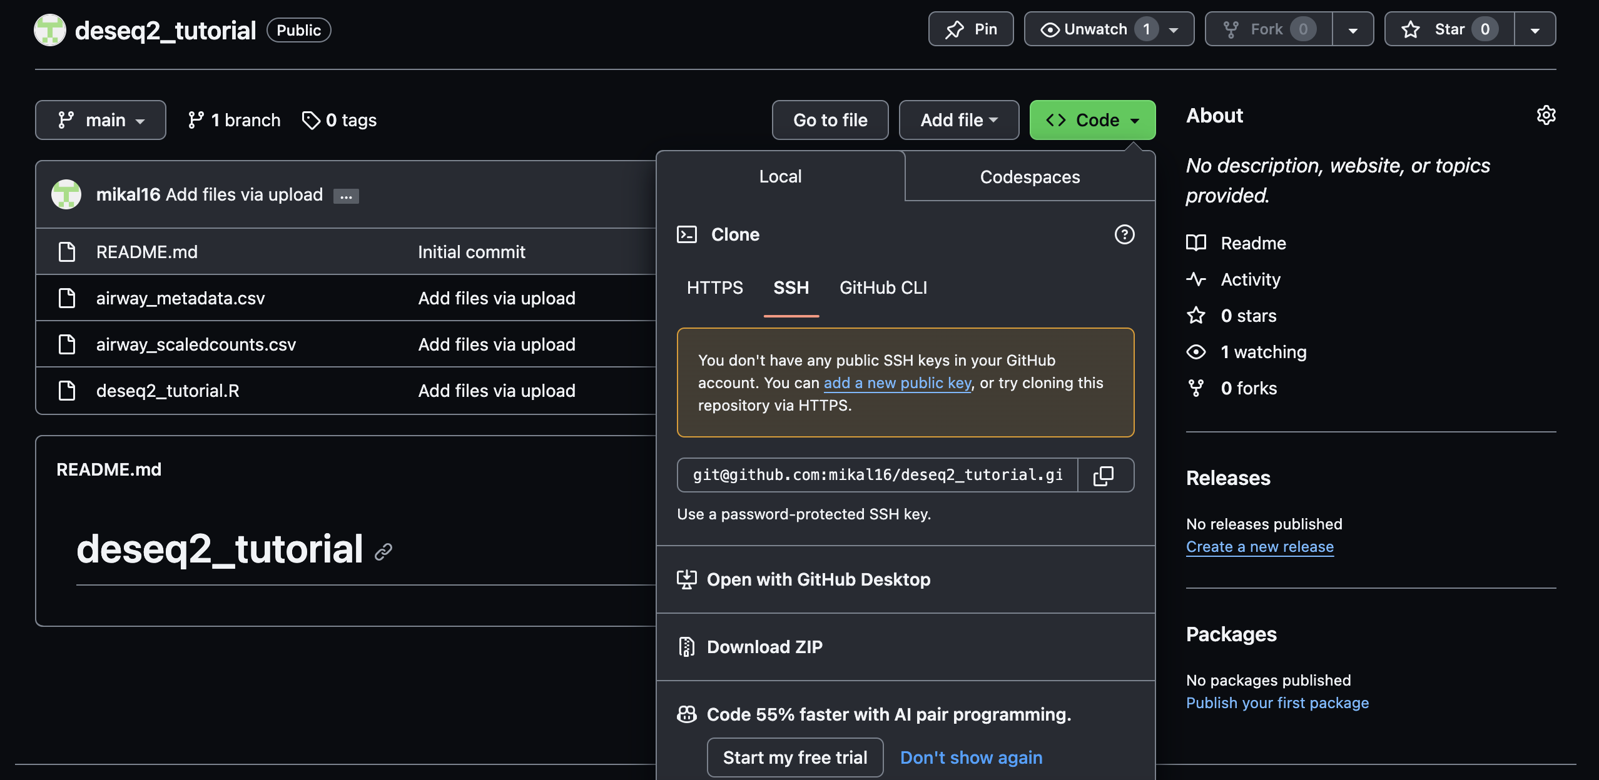
Github Page overview
https://github.com/mikal16/deseq2_tutorial

Slide 5
Class Overview
Overview of GitHub
Making your own account
Downloading and uploading files through GitHub
Overview of RNAseq workflow
Differential expression tutorial using Deseq2

Slide 6
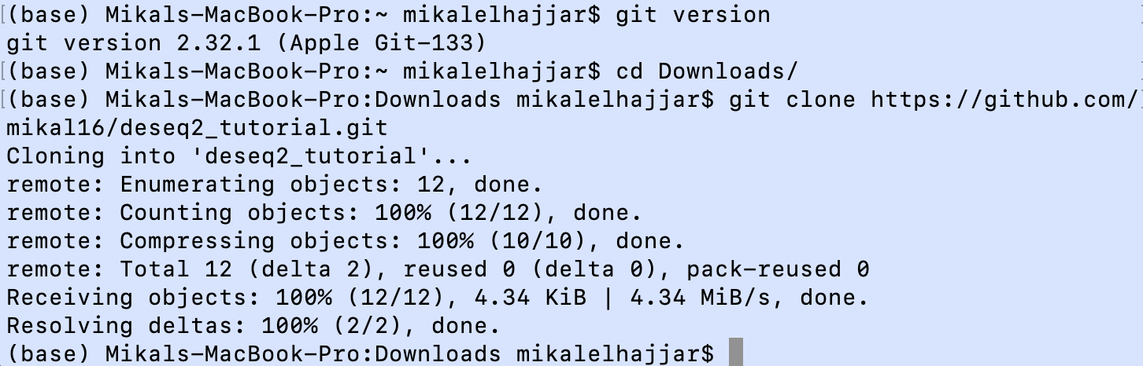
Cloning a git repository using terminal

Slide 7
Class Overview
Overview of GitHub
Making your own account
Downloading and uploading files through GitHub
Overview of RNAseq workflow
Differential expression tutorial using Deseq2

Slide 8
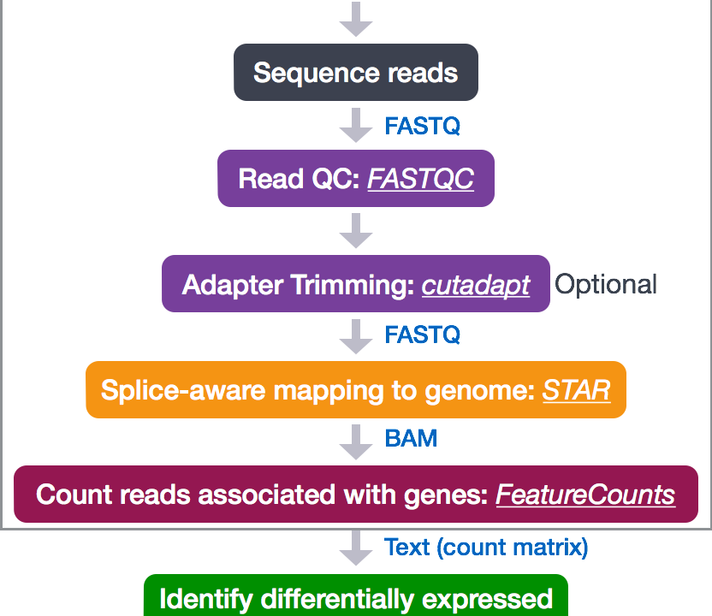
Overview of RNA-Seq workflow
https://hbctraining.github.io/DGE_workshop/lessons/01_DGE_setup_and_overview.html

Slide 9
Class Overview
Overview of GitHub
Making your own account
Downloading and uploading files through GitHub
Overview of RNAseq workflow
Differential expression tutorial using Deseq2

Slide 10
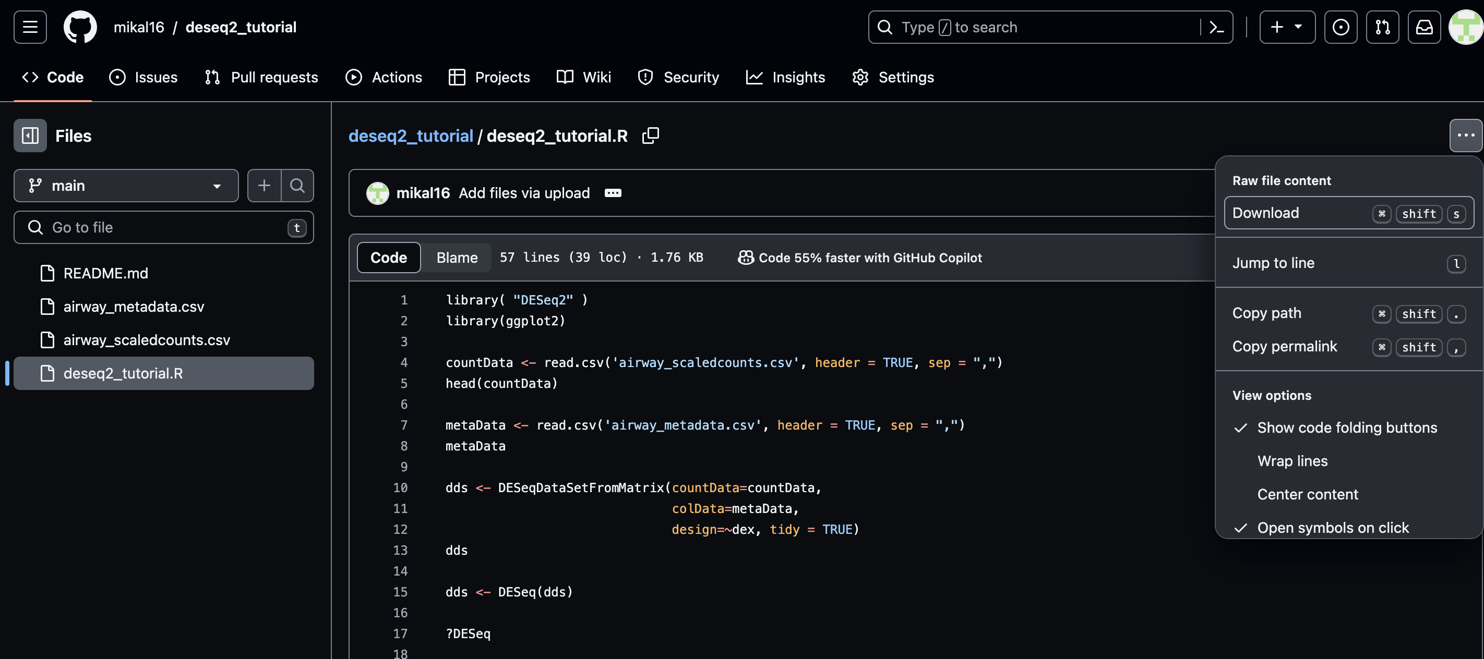
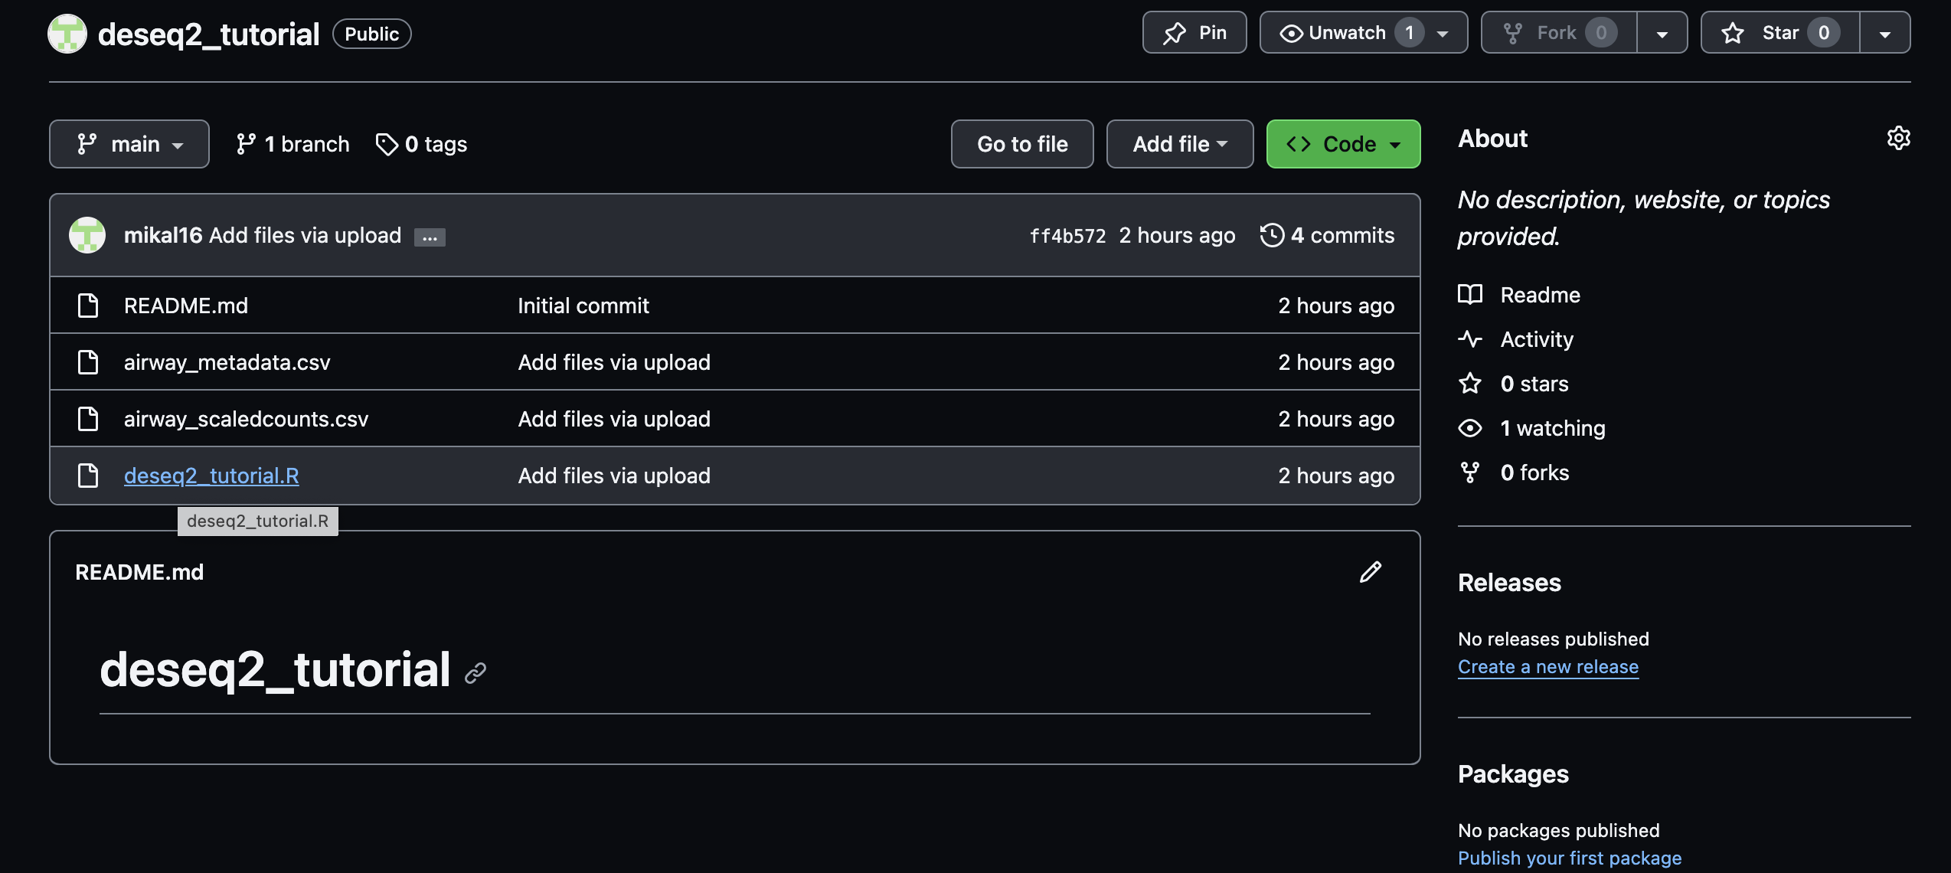
R Script for differential expression analysis

